Slide 1
Lecture 9:
Training Neural Networks
Part III

Slide 2
Overview
One time setup
activation functions, preprocessing, weight initialization, regularization, gradient checking
Training dynamics
babysitting the learning process,
hyperparameter optimization, parameter updates
Evaluation
model ensembles

Slide 3
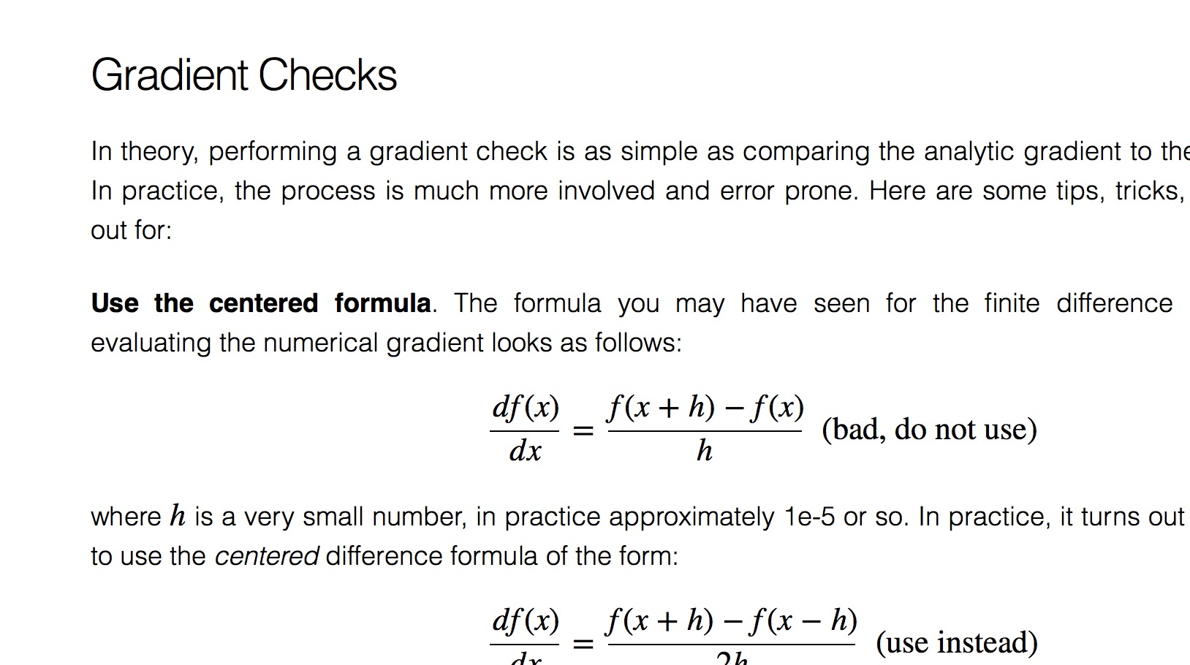

Slide 4
Babysitting the Learning Process

Slide 5
Overview
One time setup
activation functions, preprocessing, weight initialization, regularization, gradient checking
Training dynamics
babysitting the learning process,
hyperparameter optimization, parameter updates
Evaluation
model ensembles

Slide 6
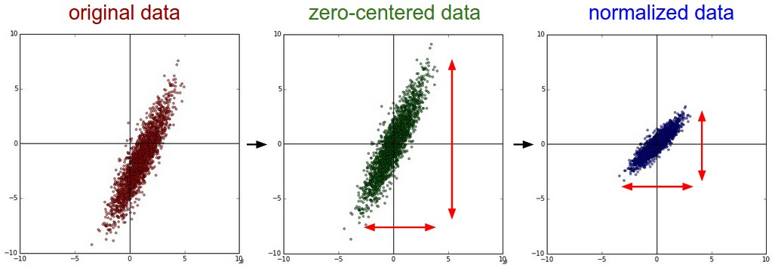
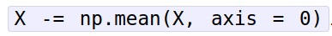
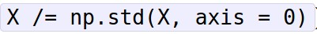
Step 1: Preprocess the data
(Assume X [NxD] is data matrix, each example in a row)

Slide 7
Step 2: Choose the architecture:
say we start with one hidden layer of 50 neurons:
50 hidden neurons
10 output neurons, one per class
output layer
CIFAR-10 images, 3072 numbers
input layer
hidden layer

Slide 8
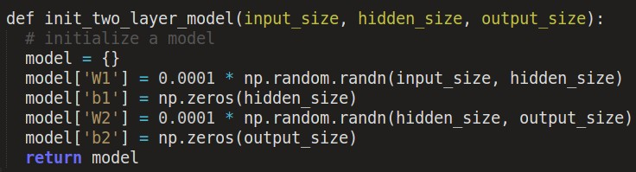
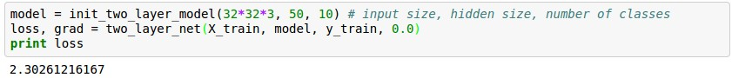
Double check that the loss is reasonable:
disable regularization
loss ~2.3.
“correct “ for
10 classes
returns the loss and the gradient for all parameters

Slide 9
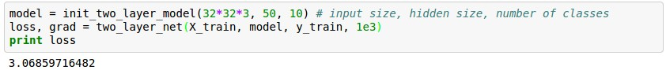
Double check that the loss is reasonable:
crank up regularization
loss went up, good. (sanity check)

Slide 10
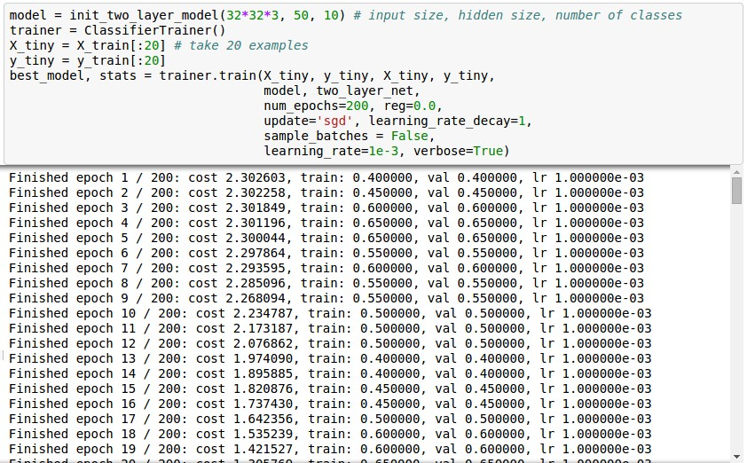
Lets try to train now…
Tip: Make sure that you can overfit very small portion of the training data
The above code:
take the first 20 examples from CIFAR-10
turn off regularization (reg = 0.0)
use simple vanilla ‘sgd’

Slide 11
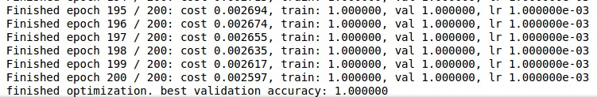
Lets try to train now…
Tip: Make sure that you can overfit very small portion of the training data
Very small loss,
train accuracy 1.00,
nice!

Slide 12
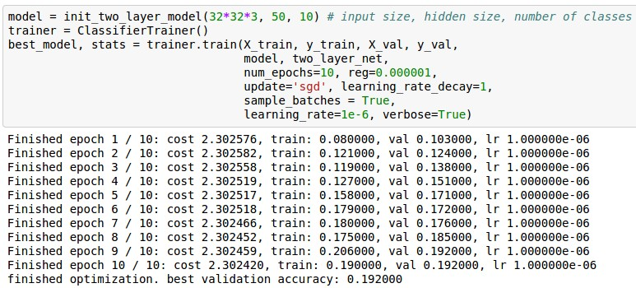
Lets try to train now…
I like to start with small regularization and find learning rate that makes the loss go down.

Slide 13
Lets try to train now…
I like to start with small regularization and find learning rate that makes the loss go down.
Loss barely changing

Slide 14
Lets try to train now…
I like to start with small regularization and find learning rate that makes the loss go down.
loss not going down:
learning rate too low
Loss barely changing: Learning rate is probably too low

Slide 15
Lets try to train now…
I like to start with small regularization and find learning rate that makes the loss go down.
loss not going down:
learning rate too low
Loss barely changing: Learning rate is probably too low
Notice train/val accuracy goes to 20% though, what’s up with that? (remember this is softmax)

Slide 16
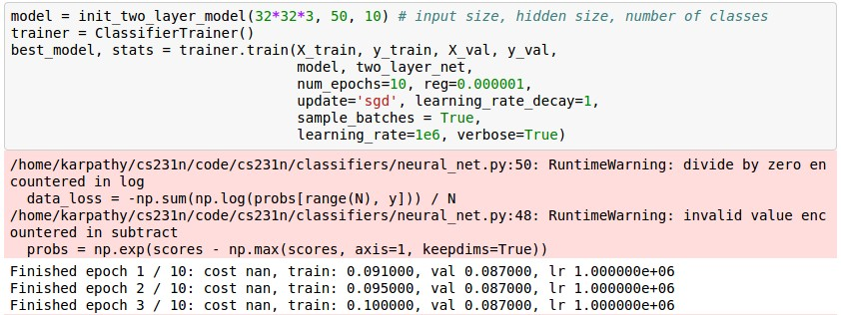
Lets try to train now…
I like to start with small regularization and find learning rate that makes the loss go down.
loss not going down:
learning rate too low
Okay now let’s try learning rate 1e6. What could possibly go wrong?

Slide 17
Lets try to train now…
I like to start with small regularization and find learning rate that makes the loss go down.
loss not going down:
learning rate too low
loss exploding:
learning rate too high
cost: NaN almost always means high learning rate...

Slide 18
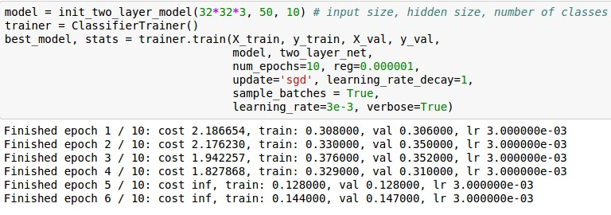
Lets try to train now…
I like to start with small regularization and find learning rate that makes the loss go down.
loss not going down:
learning rate too low
loss exploding:
learning rate too high
3e-3 is still too high. Cost explodes….
=> Rough range for learning rate we should be cross-validating is somewhere [1e-3 … 1e-5]

Slide 19
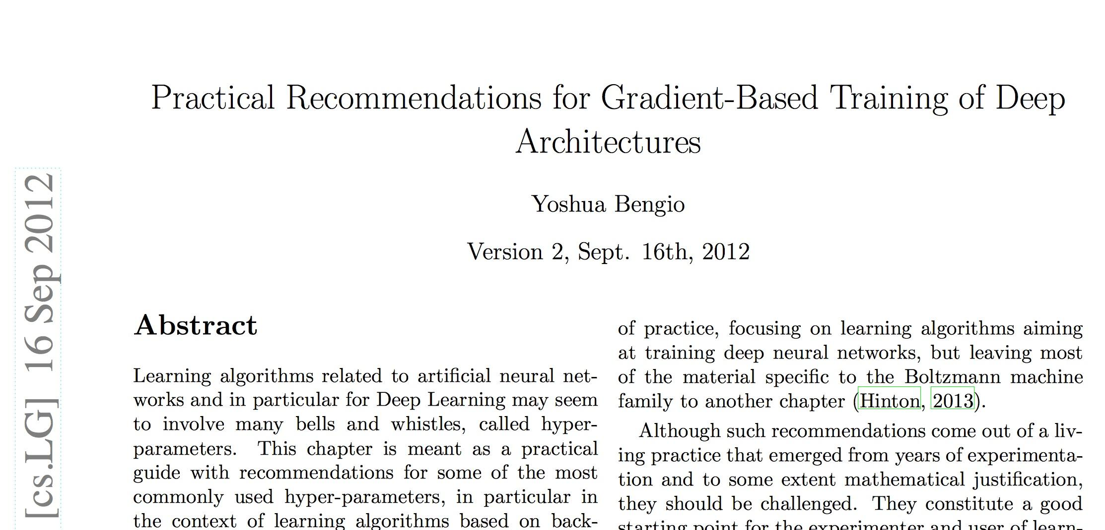
Read this!

Slide 20
Hyperparameter Optimization

Slide 21
Cross-validation strategy
I like to do coarse -> fine cross-validation in stages
First stage: only a few epochs to get rough idea of what params work
Second stage: longer running time, finer search
… (repeat as necessary)
Tip for detecting explosions in the solver:
If the cost is ever > 3 * original cost, break out early

Slide 22
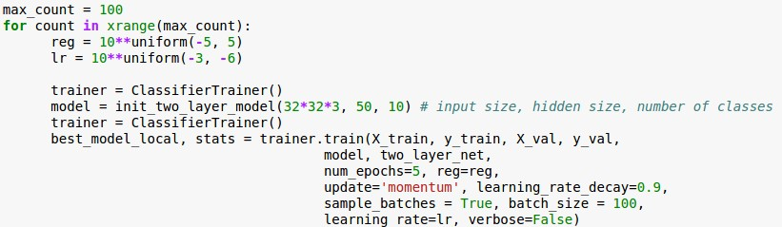
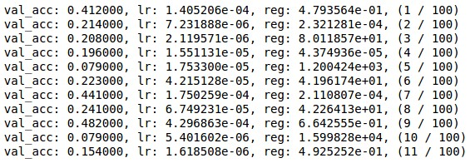
For example: run coarse search for 5 epochs
note it’s best to optimize in log space!
nice
Notes:
from numpy.random import uniform

Slide 23
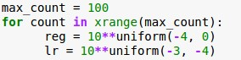
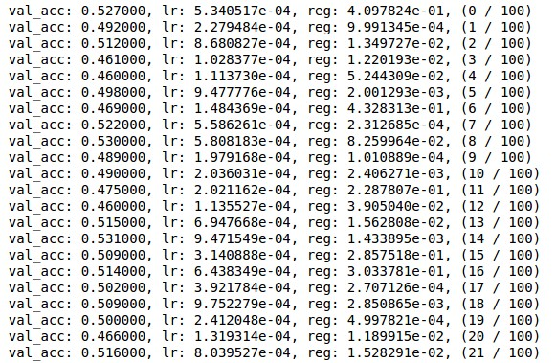
Now run finer search...
adjust range
53% - relatively good for a 2-layer neural net with 50 hidden neurons.

Slide 24
Now run finer search...
adjust range
53% - relatively good for a 2-layer neural net with 50 hidden neurons.
But this best cross-validation result is worrying. Why?

Slide 25
Performance as a function of hyperparameters
Why is it so discontinuous?
What are the factors that contribute to its noisiness?
Randomness of entire training set
Randomness of validation set
Randomness of training batches.
Randomness of initializations.
Sensitivity of training to
Small differences in initialization.
Small differences in hyperparameters, such as
Learning rate
Momentum
Regularization parameter

Slide 26
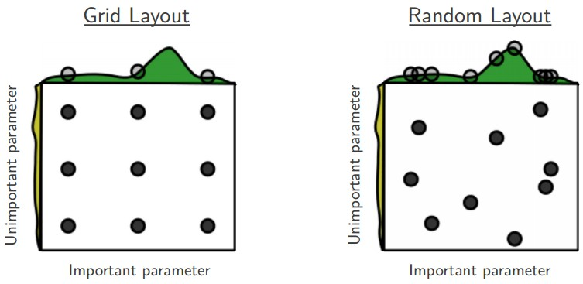
Random Search vs. Grid Search
Random Search for Hyper-Parameter Optimization
Bergstra and Bengio, 2012

Slide 27
Wait a minute!
Random Search for Hyper-Parameter Optimization
Bergstra and Bengio, 2012

Slide 28

Wait another minute!
Rotated hexagonal lattice
Hexagonal “space filling” lattice
Random Search for Hyper-Parameter Optimization
Bergstra and Bengio, 2012

Slide 29
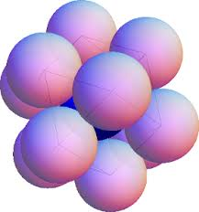

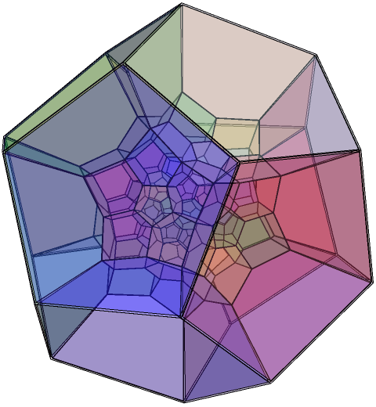
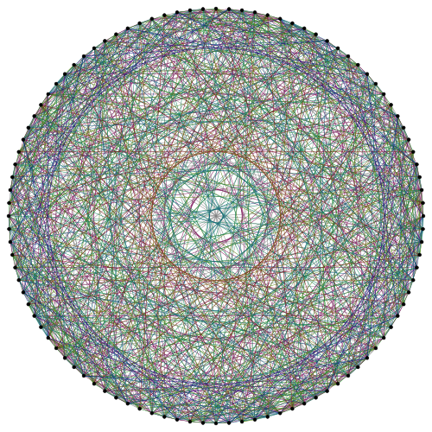
Two goals for a good sampling of hyperparameter space
In case all hyperparameters are important -- efficient coverage of full space
Hexagons in 2d
Truncated octahedra in 3d
E8 in 8d
Leech lattice in 24d
In case some parameters are not important -- efficient coverage of marginal spaces
Accomplish by searching for good rotations of lattice

Slide 30

Project idea
Hyperparameter search using Poisson Disc Sampling

Slide 31

Hyperparameters to play with:
network architecture
learning rate, its decay schedule, update type
regularization (L2/Dropout strength)
neural networks practitioner
music = loss function

Slide 32
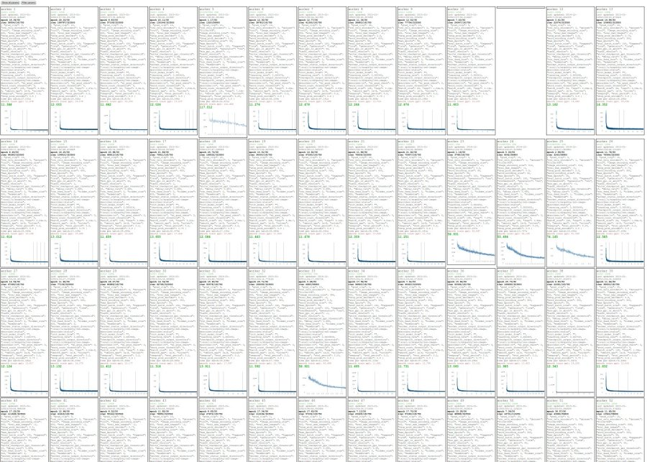
My cross-validation “command center”

Slide 33
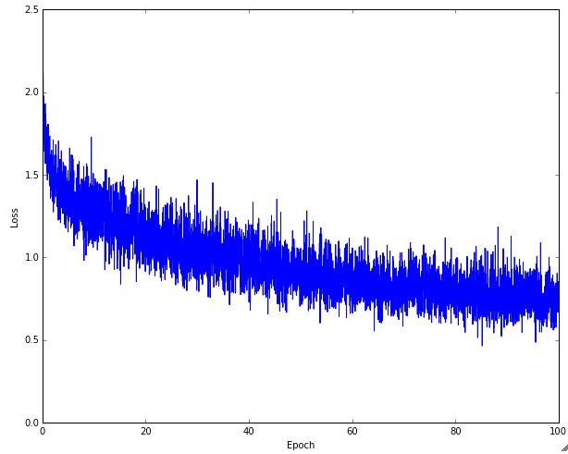
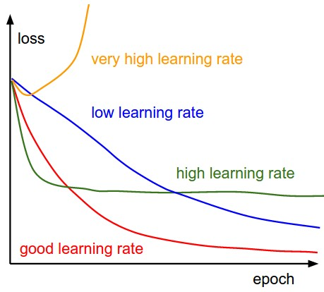
Monitor and visualize the loss curve

Slide 34
Loss
time

Slide 35
Loss
Bad initialization
a prime suspect
time

Slide 36
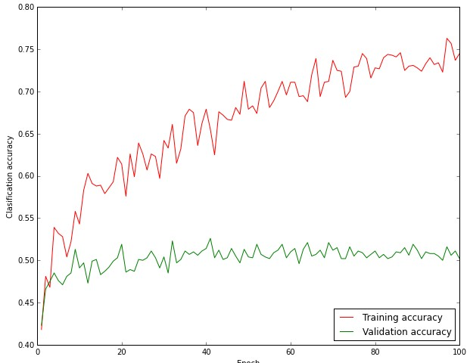
Monitor and visualize the accuracy:
big gap = overfitting
=> increase regularization strength?
no gap
=> increase model capacity?

Slide 37
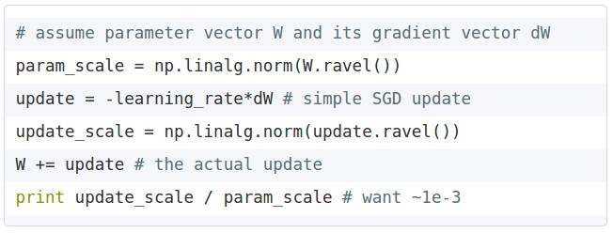
Track the ratio of weight updates / weight magnitudes:
ratio between the values and updates: ~ 0.0002 / 0.02 = 0.01 (about okay)
want this to be somewhere around 0.001 or so

Slide 38
Summary
We looked in detail at:
Activation Functions (use ReLU)
Data Preprocessing (images: subtract mean)
Weight Initialization (use Xavier init)
Batch Normalization (use)
Gradient Checking
Babysitting the Learning process
Hyperparameter Optimization
(random sample hyperparams, in log space when appropriate)
TLDRs

Slide 39
TODO
Look at:
Parameter update schemes
Learning rate schedules
Regularization (Dropout etc)
Evaluation (Ensembles etc)

